Slide 1

Cmr college of engineering and technology
CRM SYSTEMS FOR STARTUPS
BATCH NO:C_FS_32
TEAM MEMBERS:
M. SAI PRASAD (18H51A05K8)
P. HARSHITHA REDDY(18H51A05L2)
P. RAMANA SAI (18H51A05L3)
UNDER GUIDENCES OF:
N.LAVANYA

Slide 2
INDEX
Introduction
About Project
Project Analysis
System Requirements
Proposed System
System Architecture
Working
Snapchats of Application
Future Enhancement
Conclusion

Slide 3
INTRODUCTION
Customer satisfaction is a critical factor of survival and helping to maintain the economic growth. ‘Customer centricity’ swaps efficiency with effectiveness resulting in improved financial performance.
Customer relationship management (CRM) is an amalgamation of processes, people and technology that try to value the customer of a company.
This is an integrated approach to manage relationships with a focus on customer retention and relationship development.

Slide 4
With the advances in information technology, CRM has been evolving and changes in organizational structure in customer‐centric approach.
Companies, who successfully implement CRM, garner the rewards in customer loyalty and long run profitability.
For successful implementation of CRM, an integrated and balanced approach towards technology, people and process is required.

Slide 5
ABOUT PROJECT
CRM software helps startups increase efficiency and productivity in sales and marketing by making them more optimized.
This software also responsible to finding customers and engaging with them ,enables the people of sales department to provide the best customer experience possible.

Slide 6
PROJECT ANALYSIS
It’s an approach that focuses on managing relationships between the company and the customer and how to develop and retention it. If done right, the reward will be customer loyalty and long-term profitability.
Thanks to its three basic components; company-wideness, cross-functionality and customer-focus; gives the company a shared base of information which eases many processes across the enterprise.
“Customer Relationship Management (CRM) is a business strategy for improving profitability by focusing on customer needs and creating an attentive relationship with the customer.
It involves a personalized and interactive approach for the entire customer lifecycle.

Slide 7
SYSTEM REQUIREMENTS
Hardware Requirements
Processor: Pentium
RAM: 4GB
Hard Disk: 1TB
Speed: 1.1GHz
Software Requirements
Operating System: Windows
Scripting Language: JSP
Front-End: HTML5 and CSS3
Type: Web Application.
Java Version : J2SDSK1.5

Slide 8
PROPOSED SYSTEM
CRM stands for customer relationship management this includes the type of service you provide, the interactions you have, and the resources you share to match customer needs.
Create a competitive advantage as you serve customers better than your competitors.
However, the ultimate benefit of a CRM model is that it can lead to stable revenue.

Slide 9
3 common CRM models
Many CRM models have been created over the years, but they all pretty much have the same message:
IDIC CRM model
Buttle’s CRM Value Chain model
Payne & Frow’s Five-Step Process model.

Slide 10
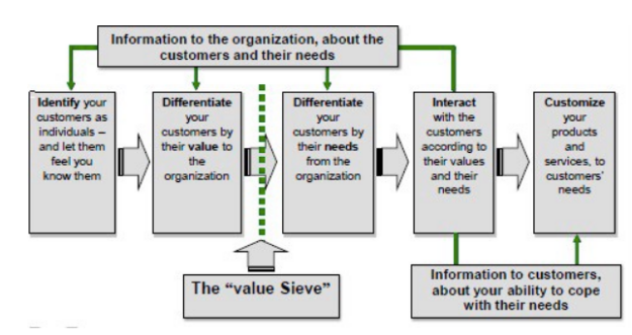
SYSTEM ARCHITECTURE

Slide 11
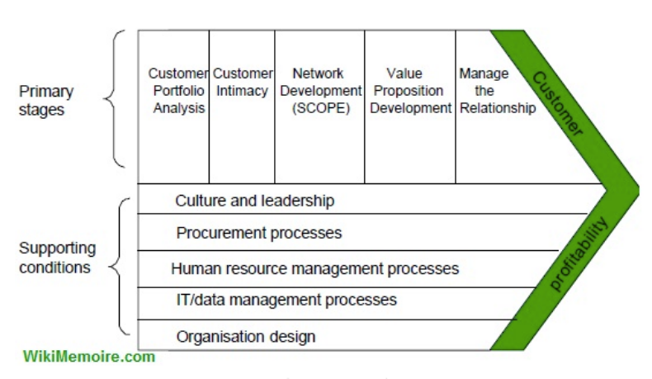
WORKING

Slide 12
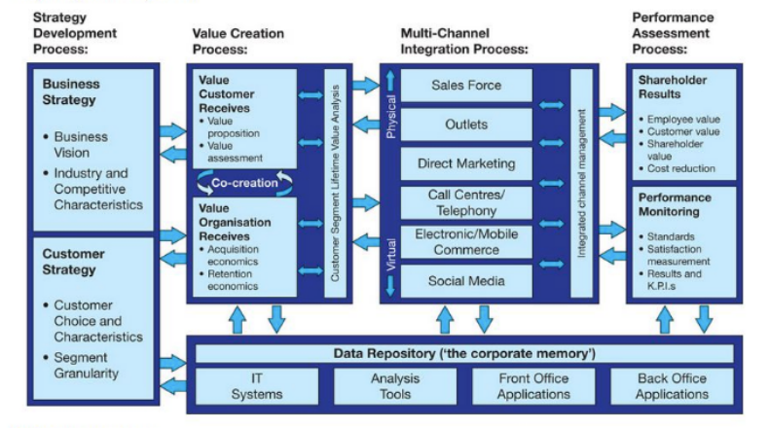

Slide 13
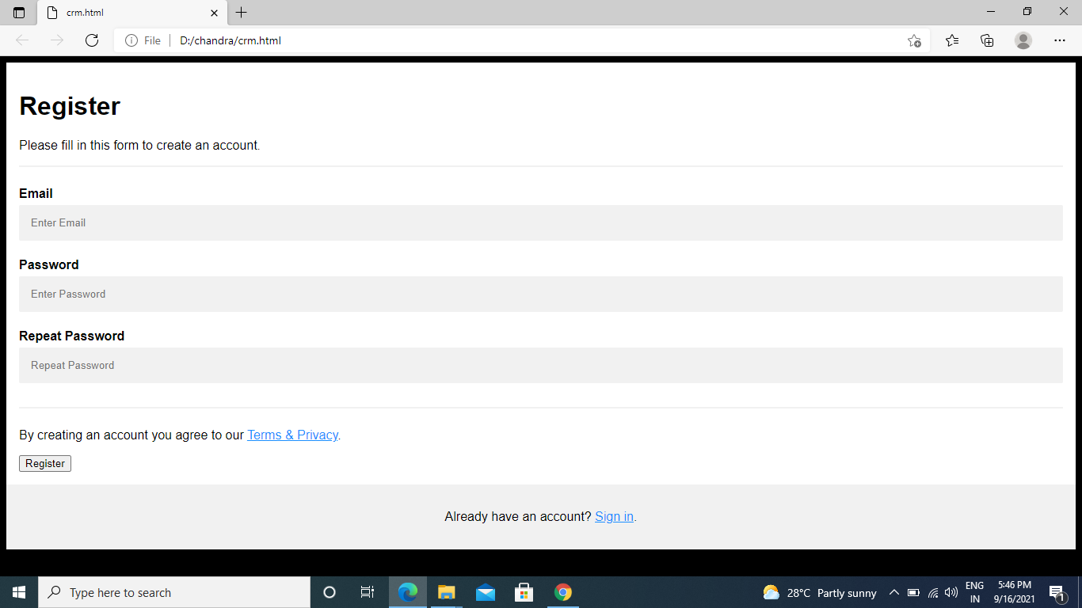
SNAPCHATS OF WEB APPLICATION
REGISTRATION PAGE

Slide 14
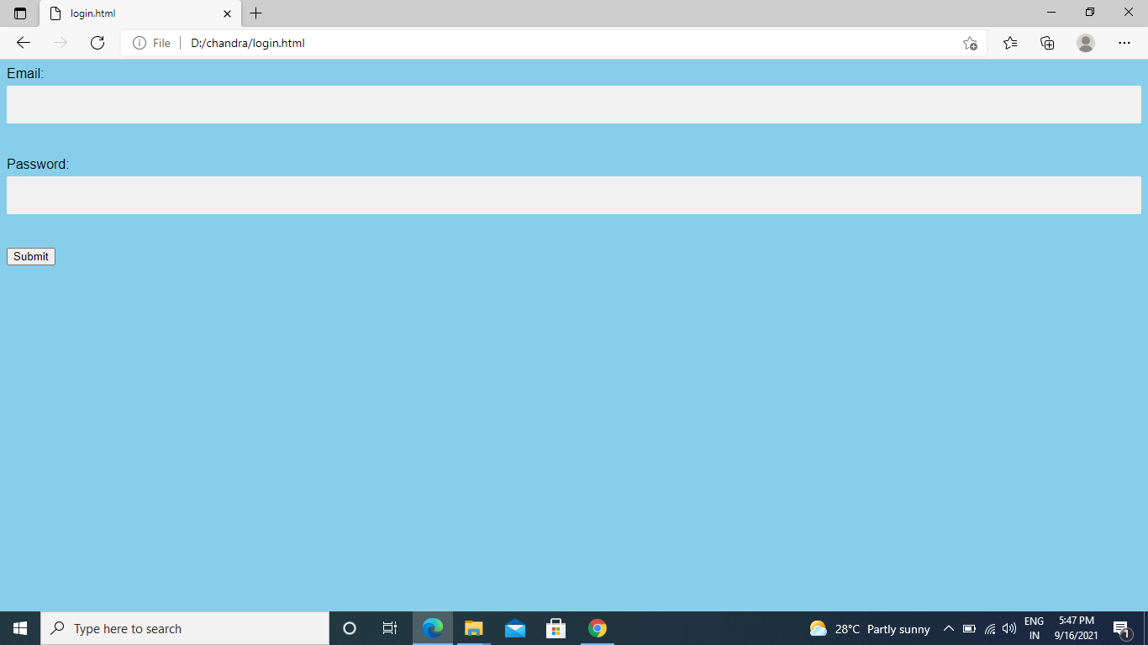
LOGIN PAGE

Slide 15
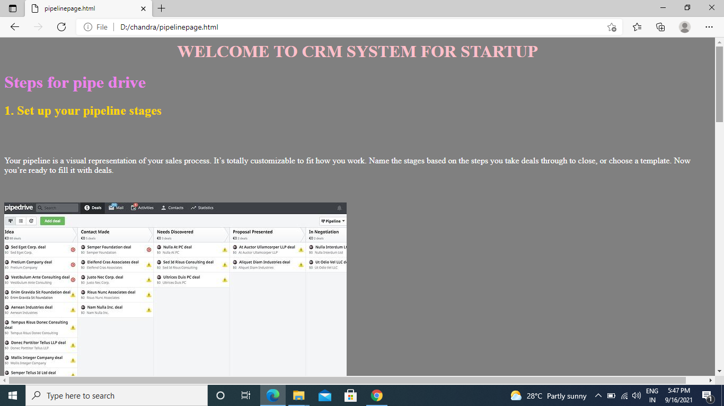
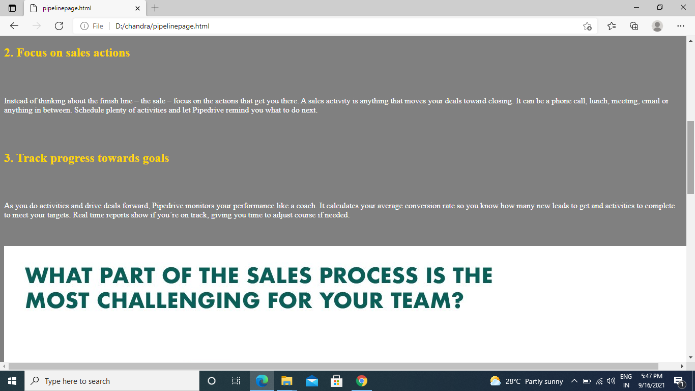
CRM PAGE

Slide 16
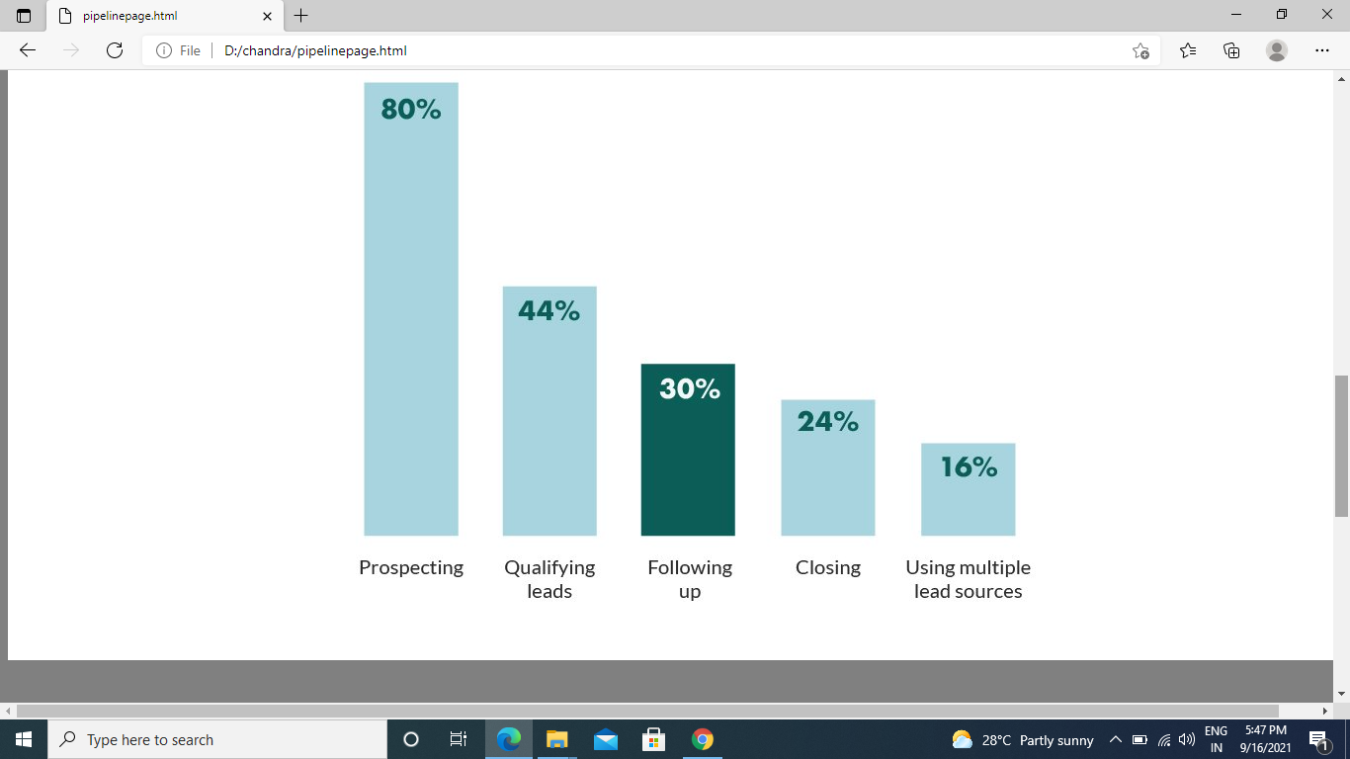

Slide 17
FUTURE ENHANCEMENT
he future has arrived — at least it has in the world of customer relationship management or CRM software, one of the fastest growing categories of enterprise software.
We are entering the era of intelligent, integrated CRM, and the future of CRM is even brighter.
From small businesses to global enterprises, sales and marketing teams are adopting CRM to deliver better customer experiences, acquire and retain customers, and gain new customer-centric insights that are changing their companies for the better.

Slide 18
CONCLUSION
Customer Relationship Management (CRM) is an important thing in the company even a small company.
Because with it the company can make a good communication in both ways the customer and the company
Furthermore, the concept of customer interaction and the ability to collect this information across any touchpoint/channel is essential as the learning curve for “who is my customer and what is the best thing for them” is to be achieved .

